Slide 1

Go, change the world
RV College of
Engineering
Title of the Project
USN
Student Name
Under the Guidance
of
Internal Guide External Guide
Designation Designation
Affiliation Affiliation
Date Department of MCA, RVCE

Slide 2

Go, change the world
RV College of
Engineering
Agenda
Introduction
Objectives of the Project Work
Changes suggested in Phase I and Incorporation
Tools and Technologies Used
Hardware and Software Requirements
Software Requirement Specifications
References

Slide 3
Go, change the world
RV College of
Engineering
Introduction
The problem identified for the development of the PLM application is the lack of an efficient and comprehensive system to manage the entire product lifecycle.
Existing processes often involve manual and disconnected methods, leading to inefficiencies, errors, and delays in product development, as well as difficulties in collaboration and data management.
The domain of work for the PLM application encompasses product lifecycle management across various industries and sectors.
It caters to organizations involved in designing, engineering. manufacturing, and marketing of products, spanning from consumer goods to industrial machinery, electronics, automotive, and more.

Slide 4
Go, change the world
RV College of
Engineering
Objectives
Gathering the requirement for development of application, designing the system and designing the architecture.
Applying the Agile approach for developing the core module
Integration of the module and managing the data.
Testing the application and deployment

Slide 5
Go, change the world
RV College of
Engineering
Incorporation of Changes
Changes in Title name
The title name was developing custom Product Lifecyle management application and it was changed to Development of custom application for product lifecycle management
Changes in Objectives
  The changes were incorporated, and Objectives were changed

Slide 6
Go, change the world
RV College of
Engineering
Project based Learning
Sl No | Particulars / Details | Details of Implementation
1 | Azure Devops | Used for deploying the application

Slide 7
Go, change the world
RV College of
Engineering
List of Tools and Technologies
Java
Java SWT
JFace
Eclipse RPC
C/C++
Google Web Toolkit (GWT)
Angular JS
SQL

Slide 8
Go, change the world
RV College of
Engineering
Design Methodology
software Requirements:
Windows 10 Enterprise or Professional (64-bit only) version 20H2 or later
Or Windows 11 Enterprise or Professional version 21H2 or later
Internet Explorer 11
  Solid Edge, while not dependent on any other browser, has been certified against other modern and popular browsers like Google Chrome, Microsoft Edge, and Mozilla Firefox.
Microsoft Office 2019, 2021, and Microsoft Office 365 Business

Slide 9
Go, change the world
RV College of
Engineering
Design Methodology
Hardware Requirement:
Recommended system configuration
Windows 10 Enterprise or Professional (64-bit only) version 20H2 or later
9.0 GB of disk space required for installation (includes prerequisites)
32 GB RAM or more
True Color (32-bit) or 16 million colors (24-bit)
Screen Resolution: 1920 x 1080
Video RAM: 2GB
Minimum system configuration
Windows 10 Enterprise or Professional (64-bit only) version 20H2 or later
9.0 GB of disk space required for installation (includes prerequisites)
16 GB RAM for commercial users and 8 GB RAM for academic users
65K Colors
Screen Resolution: 1920 x 1080

Slide 10
Go, change the world
RV College of
Engineering
Software Requirement Specification
Data Management: This module focuses on managing product data throughout its lifecycle, including data organization, classification, version control, revision management, and access control.
Document Management: This module facilitates the management of documents associated with product development, such as specifications, drawings, manuals, and other technical documents. It includes document check-in/check-out, review and approval workflows, document change management, and document search and retrieval functionalities.
Change Management: This module enables the management of change requests and engineering change orders (ECOs). It includes change impact analysis, change tracking, change notification, approval workflows, and proper documentation and communication of engineering changes.
BOM Management: The Bill of Materials (BOM) Management module allows the creation, management, and visualization of product structures. It supports the definition of BOM hierarchies, association of parts and assemblies, multi-level BOM management, and the generation of BOM reports and visualizations.

Slide 11
Go, change the world
RV College of
Engineering
Software Requirement Specification
Workflow and Process Management: This module enables organizations to define and automate workflows and processes related to product development. It includes task assignments, approvals, notifications, and reporting to improve collaboration and ensure adherence to established procedures.
CAD Integration: Teamcenter integrates with various computer-aided design (CAD) tools, allowing seamless integration between Teamcenter and CAD software for efficient management and synchronization of CAD files, metadata, and design revisions.
Supplier Collaboration: This module facilitates collaboration with external suppliers and partners throughout the product development process. It supports secure information sharing, document exchange, request for quotations (RFQs), supplier quality management, and supplier collaboration workflows.
Quality Management: The Quality Management module provides functionalities for managing product quality throughout its lifecycle. It includes quality plan definition, inspections and audits, non-conformance tracking, corrective and preventive actions (CAPAs), and quality metrics tracking.

Slide 12
Go, change the world
RV College of
Engineering
Software Requirement Specification
Requirements Management: This module focuses on capturing, managing, and tracing product requirements. It includes features for requirement definition, requirement traceability, impact analysis, and validation to ensure compliance with customer and regulatory requirements.
Manufacturing Process Management: This module supports the management of manufacturing processes, work instructions, and routing data. It includes features for process planning, resource allocation, shop floor execution, and visibility into manufacturing status.
Maintenance, Repair, and Overhaul (MRO): This module facilitates the management of maintenance, repair, and overhaul processes for products. It includes capabilities for tracking asset performance, scheduling maintenance activities, managing spare parts, and documenting maintenance history.
Reporting and Analytics: Teamcenter includes reporting and analytics capabilities for generating comprehensive reports, performance metrics, and analytics dashboards. These features provide insights into product data, process efficiency, project status, and other key performance indicators (KPIs) for informed decision-making.

Slide 13
Go, change the world
RV College of
Engineering
Software Requirement Specification
Module Name: Data Management
Purpose: The Data Management module in Teamcenter focuses on managing product data throughout its lifecycle. It provides a centralized repository and robust tools for organizing, storing, and controlling product-related information.
Input: The input for the Data Management module includes various types of product data, such as CAD files, documents, specifications, bills of materials (BOMs), and associated metadata. It may also receive inputs from other modules, such as change management or requirements management, which generate data that needs to be stored and managed.
Function: The Data Management module performs several key functions. It enables the organization and classification of product data, allowing users to structure information based on predefined categories and attributes. It also facilitates version control, ensuring that different revisions of data are properly managed and accessible. The module handles access control, defining user permissions and restrictions to ensure data security and compliance.
Output: The primary output of the Data Management module is well-organized and controlled product data. Users can efficiently retrieve and access the latest versions of files and associated metadata. The module also generates audit trails and logs, capturing information about data changes, user activities, and system events. This output supports data integrity, traceability, and compliance with regulatory requirements.

Slide 14
Go, change the world
RV College of
Engineering
Software Requirement Specification
Module Name: Document Management
Purpose: The Document Management module in Teamcenter focuses on managing documents related to product development, such as specifications, drawings, manuals, and technical documents. It provides a centralized repository and tools for efficient document storage, retrieval, and collaboration.
Input: The input for the Document Management module includes various types of documents created during the product development process. These documents may originate from different sources, such as CAD systems, office productivity software, or scanned hard copies.
Function: The Document Management module enables users to check documents in and out, ensuring exclusive access during editing or review. It supports document versioning and change tracking, allowing users to view the history of changes made to a document over time. The module facilitates document collaboration by providing capabilities for comment tracking, markups, and review workflows. It also includes search functionality, allowing users to locate documents based on attributes, keywords, or metadata.
Output: The output of the Document Management module is streamlined and efficient document management. Users can access the latest versions of documents, collaborate with others by sharing feedback and annotations, and ensure proper control and visibility of document changes. The module also generates document change notifications, approval records, and access logs, providing an audit trail of document-related activities.

Slide 15
Go, change the world
RV College of
Engineering
Software Requirement Specification
Module Name: Change Management
Purpose: The Change Management module in Teamcenter is designed to manage change requests and engineering change orders (ECOs) throughout the product development process. It provides a structured and controlled approach to implementing changes, ensuring that they are properly evaluated, documented, and communicated.
Input: The input for the Change Management module includes change requests generated by users or other modules, such as requirements management or quality management. These requests typically contain information about the proposed change, its rationale, and the affected product components.
Function: The Change Management module facilitates the evaluation and review of change requests. It enables impact analysis to assess the potential effects of the proposed change on various aspects, such as cost, schedule, resources, and product performance. The module also supports the creation and management of engineering change orders (ECOs) to document and track approved changes. It includes workflows for change approval, notification, and implementation, ensuring that changes are properly reviewed, authorized, and communicated to relevant stakeholders.
Output: The output of the Change Management module is controlled and documented changes within the product development process. It provides a record of approved changes, associated documentation, and the implementation status. The module generates change notification records, change history logs, and change impact reports, supporting traceability and compliance with established change management processes.

Slide 16
Go, change the world
RV College of
Engineering
Software Requirement Specification
Module Name: BOM Management
Purpose: The BOM Management module in Teamcenter focuses on the creation, management, and visualization of the Bill of Materials (BOM). It provides a structured representation of the product structure, including its components, assemblies, and their relationships.
Input: The input for the BOM Management module includes information about product components, assemblies, and their hierarchical relationships. This data may originate from various sources, such as CAD systems, engineering documentation, or inputs from other modules.
Function: The BOM Management module enables the creation and maintenance of BOM structures. It allows users to define and manage the relationships between components, specify quantities, and assign attributes to each item. The module supports multi-level BOM management, allowing users to represent complex product hierarchies. It also provides visualization capabilities, enabling users to view and analyze BOM structures in various formats.
Output: The primary output of the BOM Management module is a well-structured and visual representation of the product structure. Users can access and navigate the BOM, view component details, and analyze relationships between items. The module generates BOM reports, structure visualizations, and exportable BOM data, facilitating communication and collaboration among cross-functional teams.

Slide 17
Go, change the world
RV College of
Engineering
Software Requirement Specification
Module Name: Workflow and Process Management
Purpose: The Workflow and Process Management module in Teamcenter enables organizations to define and automate workflows and processes related to product development. It provides a framework for streamlining and controlling activities, ensuring that tasks are assigned, executed, and tracked according to predefined procedures.
Input: The input for the Workflow and Process Management module includes predefined workflows, process definitions, and task templates. These inputs are typically created and customized by administrators or process owners to align with the organization's specific product development processes.
Function: The Workflow and Process Management module facilitates task assignment and tracking, ensuring that activities are assigned to the appropriate individuals or groups. It enables the definition of approval workflows, routing tasks to the relevant stakeholders for review and authorization. The module supports task notifications and escalations, ensuring timely completion of activities. It also includes reporting and monitoring functionalities, allowing users to track process status, identify bottlenecks, and measure process efficiency.
Output: The output of the Workflow and Process Management module is improved process efficiency, visibility, and adherence to established procedures. It provides a structured and automated approach to executing product development tasks, ensuring that they are completed within defined timelines and according to predefined rules. The module generates task status reports, process performance metrics, and workflow audit trails, enabling organizations to continuously improve their processes.

Slide 18
Go, change the world
RV College of
Engineering
Software Requirement Specification
Module Name: CAD Integration
Purpose: The CAD Integration module in Teamcenter enables seamless integration between Teamcenter and various computer-aided design (CAD) tools. It facilitates the management and synchronization of CAD files, metadata, and design revisions within the PLM environment.
Input: The input for the CAD Integration module includes CAD files and associated metadata created and modified using CAD software, such as Siemens NX, Solid Edge, AutoCAD, or other supported CAD tools. It also receives inputs from other modules, such as BOM management or change management, which may require CAD data for their operations.
Function: The CAD Integration module allows users to access CAD files directly from within Teamcenter, eliminating the need for separate CAD software interfaces. It enables CAD data check-in/check-out to control access and ensure version control. The module provides capabilities for managing CAD file relationships, associating CAD files with product structures, and synchronizing design changes between Teamcenter and the CAD software. It also supports visualization of CAD data, allowing users to view, interrogate, and analyze 3D models and drawings.
Output: The primary output of the CAD Integration module is synchronized and controlled CAD data within the PLM environment. Users can access the latest versions of CAD files, manage their relationships with other product components, and track design changes. The module generates CAD-related reports, visualizations, and metadata, supporting collaboration and decision-making during the product development process.

Slide 19
Go, change the world
RV College of
Engineering
Software Requirement Specification
Module Name: Supplier Collaboration
Purpose: The Supplier Collaboration module in Teamcenter facilitates collaboration with external suppliers and partners throughout the product development lifecycle. It provides a secure and structured environment for sharing information, documents, and collaborating on design, sourcing, and manufacturing activities.
Input: The input for the Supplier Collaboration module includes supplier information, communication channels, and collaboration requirements defined by the organization. It also involves inputs from other modules, such as BOM management or change management, which may require supplier involvement or input.
Function: The Supplier Collaboration module enables secure information exchange between the organization and its suppliers. It supports document sharing, allowing users to share technical specifications, drawings, and other relevant documentation with suppliers. The module includes request for quotation (RFQ) capabilities, streamlining the procurement process. It also facilitates supplier collaboration workflows, ensuring smooth communication, and coordination for design reviews, sample approvals, and other activities involving suppliers.
Output: The output of the Supplier Collaboration module is enhanced collaboration and communication with external suppliers. Users can exchange information, receive quotations, and collaborate on design and sourcing activities in a controlled and traceable manner. The module generates records of supplier interactions, communication logs, and audit trails, supporting supplier performance evaluation and maintaining a history of collaboration activities.

Slide 20
Go, change the world
RV College of
Engineering
Software Requirement Specification
Module Name: Quality Management
Purpose: The Quality Management module in Teamcenter focuses on managing product quality throughout its lifecycle. It provides tools and processes for defining, monitoring, and improving quality standards and practices.
Input: The input for the Quality Management module includes quality requirements, specifications, inspection plans, and non-conformance data. It also receives inputs from other modules, such as BOM management or change management, which may impact quality-related activities.
Function: The Quality Management module allows users to define quality plans and requirements for products. It supports the creation and management of inspection plans, defining the criteria, methods, and frequency of inspections. The module enables the recording and tracking of non-conformance instances, initiating corrective and preventive actions (CAPAs) to address quality issues. It also includes capabilities for quality audits, metrics tracking, and generating quality-related reports.
Output: The output of the Quality Management module is improved product quality and compliance. Users can ensure that products meet defined quality standards, track and address non-conformance instances, and implement corrective actions to prevent recurrence. The module generates quality reports, performance metrics, and audit records, enabling organizations to monitor and continuously improve their quality processes.

Slide 21
Go, change the world
RV College of
Engineering
Software Requirement Specification
Module Name: Requirements Management
Purpose: The Requirements Management module in Teamcenter focuses on capturing, managing, and tracing product requirements. It provides a structured approach to defining, organizing, and tracking requirements throughout the product development lifecycle.
Input: The input for the Requirements Management module includes user needs, customer requirements, industry standards, and regulations. It also receives inputs from other modules, such as change management or BOM management, which may require traceability to specific requirements.
Function: The Requirements Management module enables users to capture and document product requirements. It supports the definition of requirements hierarchies, linking requirements to related components and specifications. The module facilitates traceability, allowing users to track the relationship between requirements and design elements, test cases, and other project artifacts. It also includes change management capabilities, ensuring that requirement changes are properly evaluated, documented, and communicated.
Output: The output of the Requirements Management module is a well-documented and traceable set of product requirements. Users can access and review requirements, track their status, and analyze their impact on the overall product development process. The module generates requirement traceability matrices, impact analysis reports, and requirement change history logs, supporting compliance, and effective requirement management.

Slide 22
Go, change the world
RV College of
Engineering
Software Requirement Specification
Module Name: Manufacturing Process Management
Purpose: The Manufacturing Process Management module in Teamcenter focuses on managing the manufacturing processes, work instructions, and routing data associated with product production. It enables the planning, execution, and control of manufacturing activities.
Input: The input for the Manufacturing Process Management module includes product design data, BOMs, production resources, and manufacturing constraints. It also receives inputs from other modules, such as BOM management or change management, which impact manufacturing processes.
Function: The Manufacturing Process Management module enables users to define manufacturing processes, including work instructions, routing sequences, and resource allocation. It supports the scheduling and execution of manufacturing activities, capturing real-time production data and tracking progress. The module includes capabilities for resource management, shop floor execution, material tracking, and quality control during production. It also facilitates visibility into manufacturing status, allowing users to monitor production performance and identify bottlenecks or issues.
Output: The output of the Manufacturing Process Management module is streamlined and controlled manufacturing processes. Users can define and execute production activities efficiently, ensuring that products are manufactured according to defined specifications and standards. The module generates production schedules, work instructions, resource allocation reports, and manufacturing performance metrics, supporting process optimization and continuous improvement.

Slide 23
Go, change the world
RV College of
Engineering
Software Requirement Specification
Module Name: Maintenance, Repair, and Overhaul (MRO)
Purpose: The Maintenance, Repair, and Overhaul (MRO) module in Teamcenter focuses on managing maintenance activities for products, including asset performance tracking, scheduling maintenance tasks, and managing spare parts.
Input: The input for the MRO module includes asset information, maintenance schedules, maintenance records, and spare parts inventory. It also receives inputs from other modules, such as BOM management or change management, which may impact maintenance activities.
Function: The MRO module enables users to track asset performance, record maintenance activities, and schedule preventive or corrective maintenance tasks. It provides capabilities for managing spare parts inventory, including stock levels, procurement, and usage tracking. The module supports maintenance planning, work order generation, task assignment, and execution tracking. It also includes capabilities for capturing maintenance history and generating maintenance reports.
Output: The output of the MRO module is effective and optimized maintenance processes. Users can ensure the reliability and availability of assets, plan and execute maintenance activities, and track maintenance costs and performance. The module generates maintenance records, work orders, maintenance history logs, and performance reports, supporting asset management and maintenance optimization.

Slide 24
Go, change the world
RV College of
Engineering
Software Requirement Specification
Module Name: Reporting and Analytics
Purpose: The Reporting and Analytics module in Teamcenter provides capabilities for generating comprehensive reports, performance metrics, and analytics dashboards. It enables data analysis and visualization to support informed decision-making and process improvement.
Input: The input for the Reporting and Analytics module includes data from various modules and sources within Teamcenter, such as change management, quality management, manufacturing processes, or requirements management. It encompasses structured data, metadata, and historical records.
Function: The Reporting and Analytics module enables users to define and generate custom reports, tailored to specific requirements and key performance indicators (KPIs). It provides data visualization tools, including charts, graphs, and dashboards, to facilitate data analysis and interpretation. The module supports ad-hoc querying, data mining, and trend analysis, allowing users to uncover insights and identify areas for improvement. It also includes capabilities for scheduling and distributing reports to stakeholders.
Output: The output of the Reporting and Analytics module is meaningful and actionable insights derived from PLM data. Users can generate reports and analytics dashboards, visualize performance metrics, and identify trends or patterns. The module enables data-driven decision-making, supports process optimization, and provides a basis for continuous improvement initiatives.

Slide 25
Go, change the world
RV College of
Engineering
Software Requirement Specification
Functional Requirements:
Change Management:
  Ability to create, review, and approve change requests and engineering change orders (ECOs).
  Support for impact analysis to assess the effects of proposed changes on cost, schedule, resources, and product performance.
  Workflow management for change approval, notification, and implementation.
  Generation of change notification records, change history logs, and change impact reports.
BOM Management:
  Capability to create, manage, and visualize the Bill of Materials (BOM) structure.
  Support for multi-level BOM management and hierarchy representation.
  Ability to assign attributes, quantities, and relationships to BOM items.
  Generation of BOM reports, structure visualizations, and exportable BOM data.
Workflow and Process Management:
  Definition and automation of workflows and processes related to product development.
  Assignment, tracking, and notification of tasks according to predefined procedures.
  Approval workflows and routing of tasks to relevant stakeholders.
  Reporting and monitoring functionalities for process status and efficiency measurement.
CAD Integration:
  Seamless integration with CAD tools for managing and synchronizing CAD files and metadata.
  Check-in/check-out functionality for controlling access and version control of CAD data.
  Management of CAD file relationships and association with product structures.
  Visualization capabilities for viewing and analyzing 3D models and drawings.

Slide 26
Go, change the world
RV College of
Engineering
Software Requirement Specification
Non-Functional Requirements:
Performance:
  The system should provide efficient and responsive performance even with a large volume of data.
  Operations such as searching, retrieving, and updating data should be fast and responsive.
Scalability:
  The system should be able to handle increasing data and user loads without significant performance degradation.
  It should support scalability by accommodating additional users, modules, and data volumes.
Security:
  The PLM application should have robust security measures to protect sensitive data and prevent unauthorized access.
  User authentication, role-based access control, and data encryption should be implemented.
Reliability:
  The system should be highly reliable, with minimal downtime and data loss.
  It should have backup and recovery mechanisms to ensure data integrity and availability.

Slide 27
Go, change the world
RV College of
Engineering
Software Requirement Specification
External Interface:
The PLM application should support integration with external systems such as CAD tools, ERP systems, and other enterprise applications. It should provide APIs or standard interfaces for data exchange, ensuring seamless interoperability with these external systems.
Design Constraints:
The PLM application should be designed with the following constraints in mind:
Compatibility with the hardware and software infrastructure of the organization.
Adherence to industry standards and regulations.
Consideration of performance, scalability, and security requirements.
Compatibility with the existing IT landscape and infrastructure.

Slide 28
Go, change the world
RV College of
Engineering
Higher Level Design
Block diagram
PLM APPLICATION
DATA MANAGEMENT
DOCUMENT MANAGEMENT
CHANGE MANAGEMENT
BOM MANAGEMENT
REQUIREMENT MANAGEMENT
QUALITY MANAGEMENT
SUPPLIER COLLABRATION
CAD INTEGRATION
WORKFLOW AND PROCESS
MANUFACTURING PROCESS
REPORTING AND ANALYTICS

Slide 29
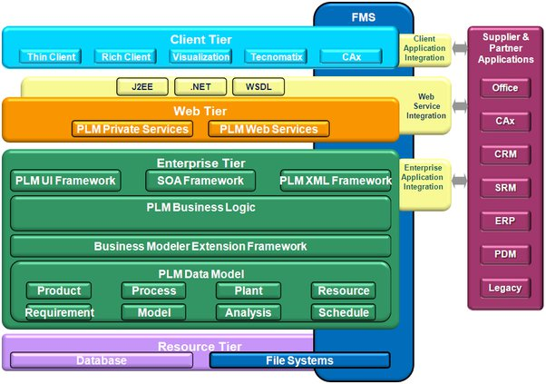
Go, change the world
RV College of
Engineering
Higher Level Design
Architectural diagram

Slide 30
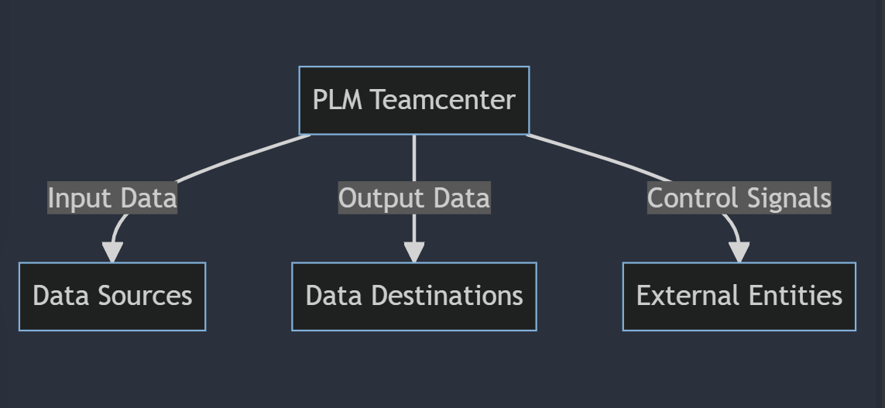
Go, change the world
DFG
RV College of
Engineering
Higher Level Design
DFD LEVEL 0

Slide 31
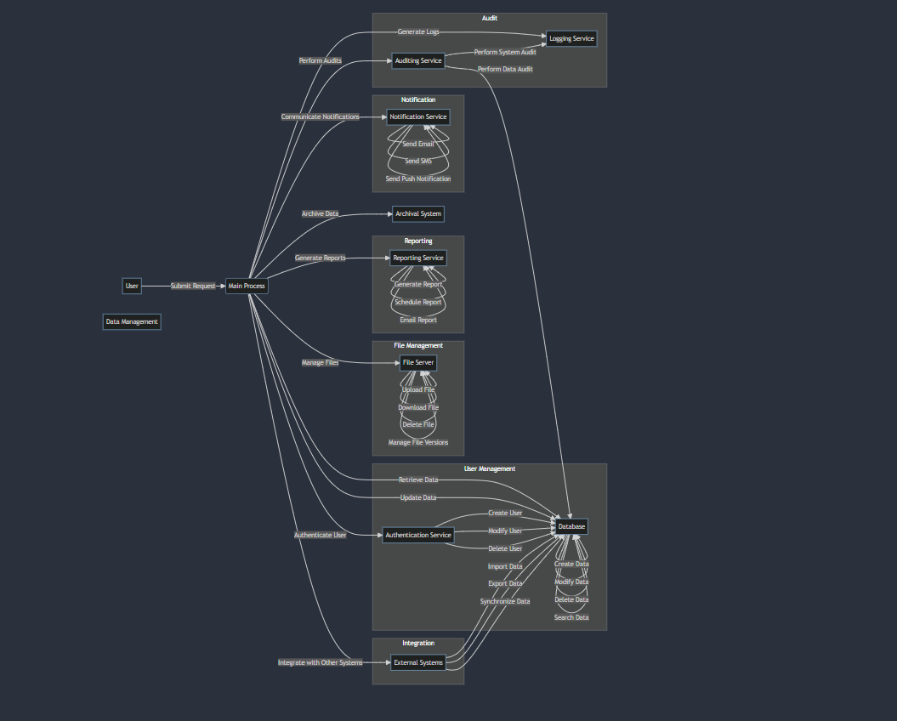
Go, change the world
RV College of
Engineering
Higher Level Design
DFD LEVEL 1

Slide 32
Go, change the world
RV College of
Engineering
Future work
70% OF WORK IS COMPLETED
FUTURE WORK
Testing the developed application and Quality Assurance
Deployment and User Training in the File System

Slide 33
Go, change the world
RV College of
Engineering
References
[1] Rajkumar Roy and David Baxter, "Product-service systems", Journal of Manufacturing Technology Management, vol. 20, pp. 327-328, 2004. https://www.researchgate.net/publication/239795242_Status_review_and_research_strategies_on_product-service_systems
[2] Robèrt Karl Henrik, "Tools and concepts for sustainable development how do they relate to a general framework for sustainable development and to each other?", Journal of Cleaner Production, vol. 8, pp. 243-254, 2000. https://www.sciencedirect.com/science/article/abs/pii/S0959652600000111
[3]B. Nattrass, The Natural Step: Corporate Learning and Innovation for Sustainability, 1999. https://web.stanford.edu/class/me221/readings/NaturalStepOverview
[4] Guo Gang, Yu Chenglong and Liu Fei, Connotation and Technology Architecture of Product Lifecycle Management, China Mechanical Engineering,2004,06, pp.512-515. https://www.ijert.org/reviewing-product-lifecycle-management-through-definitionstructure-analysis-strategies-implementation-and-applicationdsasia
[5]CIMdata, "Product Lifecycle Management, Empowering the Future of Business", www.cimdata.com, 200 https://www.academia.edu/28684633/Product_Lifecycle_Management_State_of_the_Art_and_Future_Perspectives
[6]European Commission. (2007, Jul 02). Economic reforms and competitiveness: key messages from the European Competitiveness Report 2006. https://op.europa.eu/en/publication-detail/-/publication/231e7f69-4cb9-4bbb-aef3-eb965d255281

Slide 34
THANKYOU

